Slide 1
Using Workflow to Manage Enterprise Content

Slide 2
Agenda
Introduction to Windows Workflow Foundation
Overview of Workflow Support in WSS/MOSS
Building Workflows using SharePoint Designer
Building Workflows using Visual Studio
Strategies for applying Workflow to ECM solutions

Slide 3
Introduction
What is a Workflow?
A long-running process
Has built-in support for persistence
Can be suspended or resumed by the WF runtime
Composed from a series of discrete “activities”
Atomic operations for a given domain
Activities may contain other activities
Sequential or state-machine

Slide 4
Workflows and Activities
What is a Workflow Activity?
A .NET class
Written in managed code
Compiled into a .NET assembly
Exposes properties and methods
Can be bound via reflection to other activities
Exposes interfaces
Can be called by other activities
Handles events
Events generated by the WF runtime

Slide 5
Types of Activities
Generic Activities
Code Activity
Composite Activity
If-Else, While
SharePoint-Specific Activities
Create Task
Update Task
OnTaskChanged
…

Slide 6
Sequential Workflow
Similar to a flow-chart
Harder to model complex workflows

Slide 7
State Machine Workflow
Task Reminder Workflow

Slide 8
Windows Workflow Foundation
Hosted Workflow Engine
Can be hosted in any .NET application
Custom hosting layer in WSS
Fully Integrated into .NET 3.0
Integrated into the OS
Required for running workflows

Slide 9
WF Architecture

Slide 10
WF Architecture

Slide 11
Workflow Architecture – Comparison
Web Parts
Workflow Activities
Enables developers to focus on specific requirements
Empowers users to build personalized applications
Requires higher skills to design & build
Enables high-level modeling of custom requirements
Empowers users to build custom workflows
Requires higher skills to design & build

Slide 12
Workflow in SharePoint
Primary Characteristics
Fully integrated with Windows Workflow Foundation
Every SharePoint List Item
Multiple Workflows per Item
Fully integrated with InfoPath and Forms Services
Custom Workflow Association Forms
Custom Workflow Initiation Forms
Custom Workflow Task Forms
Custom Workflow Modification Forms
Completely Extensible
Supports custom lists and content types

Slide 13
SharePoint Workflow Lifecycle

Slide 14
DEMO: Workflow in SharePoint

Slide 15
Workflow Tools: SharePoint Designer
Advantages
Easy to build declarative workflows
Outlook “rules wizard” design experience
No code – just markup
Can be extended with custom activities
Tailored to a specific application area
Integrated with legacy applications
Disadvantages
Tied to a particular list or library
Cannot reuse in other sites

Slide 16
DEMO – Building Workflows with SharePoint Designer 2007

Slide 17
Workflow Tools: Visual Studio
Advantages
Supports sequential and state machine workflows
Workflows are reusable in SharePoint
Can build non-SharePoint workflows
Full debugging support.
Disadvantages
Requires higher skills to design and build

Slide 18
ECM Workflow Strategies

Slide 19
ECM Workflow Strategies
Identify high-value targets via role-activity modeling
Capture essential content elements that drive business process
Create typed schemas that describe content elements
Construct domain-specific ECM component libraries
Convert content schemas into .NET classes
Extend content schemas to support workflow
Construct ECM workflow activity libraries
To enable declarative workflow modeling
To reduce the cost of building domain-specific workflows
Leverage SharePoint Designer
Empower non-technical knowledge workers

Slide 20
Custom Activity Libraries
Must be constructed using Visual Studio
Create a Workflow Activity Library project
Add code:
Expose Dependency Properties to WF developers
Expose Events to WF developers
Implement the Execute method
Must be installed to the GAC
Add to the Visual Studio toolbox
For inclusion in other workflows / activities
Optionally deployed to SharePoint
For use in SharePoint Designer 2007

Slide 21
Extending SharePoint Designer
Steps:
Create custom activity assembly
Sign and deploy assembly to the GAC
Configure SharePoint to recognize the activity
Create a .ACTIONS file for SharePoint Designer

Slide 22
Configuring Trusted Assemblies
Add a special web.config entry
<System.Workflow.ComponentModel.WorkflowCompiler> <authorizedType Assembly=“MyAssembly, Version=1.0.0.0, Culture=neutral, PublicKeyToken=0b97b340d4a71524” namespace=“MyCustomActivity” TypeName=“*” Authorized=“True”/>

Slide 23
Creating a .ACTIONS file
<?xml version="1.0" encoding="utf-8" ?>
<WorkflowInfo>
<Actions Sequential="then" Parallel="and">
<Action Name="Write Message To Event Log" ClassName="JohnHolliday.Workflow.EventLogger“ Assembly="JohnHolliday.Workflow.EventLoggerActivity, Version=1.0.0.0, Culture=neutral, PublicKeyToken=0b97b340d4a71524“ AppliesTo="all" Category="MyCustomActivities">
<RuleDesigner Sentence="Write '%1' to the event log"> <FieldBind Field="Message" DesignerType="TextArea" Id="1"/> </RuleDesigner>
<Parameters> <Parameter Name="Message" Type="System.String, mscorlib" Direction="In"/> </Parameters> </Action>
</Actions>
</WorkflowInfo>
Shows up in SPD Workflow Designer
Binds to the dependency property in the custom activity
Tells SPD how to invoke the activity

Slide 24
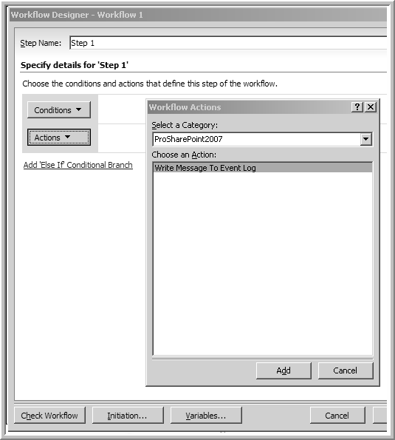
Custom Activity in SPD

Slide 25
Building ECM Activity Libraries

Slide 26
Goals
Seamless transition from content modeling (role/activity model) to workflow modeling and design
Easy conversion of ECM modeling artifacts into custom workflow activities and components
Accessibility from SharePoint Designer to support prototyping and site customization

Slide 27
Identifying Useful Activities
Get/Set structured data
Access XML form data from internal schema
Perform High-Level Operations

Slide 28
Activities + Schema
Create separate classes for related activities
Expose dependency properties in the activity
Using the XML serializer to retrieve ListItem data
Implement dependency properties

Slide 29
Sales Proposal Activities
UpdateSalesProposalActivity
ListItemId
ClientName
ClientAddress
ClientContacts
DeliverablesList
Invoke()
CreateProposalWorkspaceActivity
ListItemId
WorkspaceName
Invoke()
Dependency Properties
Allows workflow developer to add custom code

Slide 30
Summary
Workflows are long-running self-persisting processes consisting of discrete activities.
Workflow activities are like web parts – richer activities enable more powerful applications.
VSTO provides a complete platform for building custom workflows and content-specific workflow activity libraries.
ECM workflows that are driven by schematized metadata can leverage the power of custom activities to enable high-value declarative workflow development by non-technical knowledge workers.

